Slide 1
Spotify Recommendations
Using k-D Trees
Aditya Narayanan, Levon Haroutunian, Nikhil Rajkumar

Slide 2
Contents
Purpose
Spotify Data Collection
Data Preprocessing
Exploratory Data Analysis
Modeling [Tutorial Component]
  Brute Force Model
  k-D Tree
Results and Model Comparisons
Challenges
Notes:
2-4: 4 mins
5a: 3 mins
5b: 3 mins
result/demo: 2-3 mins
Questions: 2 mins

Slide 3
Main Claim
Tree-like-models such as k-D Trees perform better than Brute Force models in the implementation of Unsupervised Nearest Neighbor searches. We aim to compare both models using Spotify Data to provide song recommendations
Notes:
We aim to research and compare Nearest Neighbor algorithms that could help us achieve the task of recommending songs to users using Spotify Data. Our project compares the use of Brute-Force and KD-Tree Nearest Neighbor algorithms respectively
Spotify API
Most songs available to play on Spotify have an associated list of attributes that are available on the API. Some are trivial and objective descriptors, like the title, artist, year release, etc. Others are subjective measures produced from Spotify's algorithms that analyze the audio files of the songs. These include things like danceability, valence, etc, which are scaled from 0.0 to 1.0. The API describes songs that are happy and uplifting to have a higher valence values. “A measure from 0.0 to 1.0 describing the musical positiveness conveyed by a track. Tracks with high valence sound more positive (e.g. happy, cheerful, euphoric), while tracks with low valence sound more negative (e.g. sad, depressed, angry).”

Slide 4
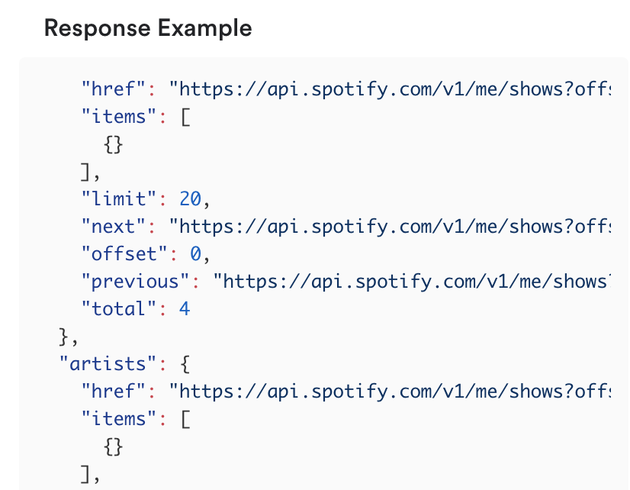
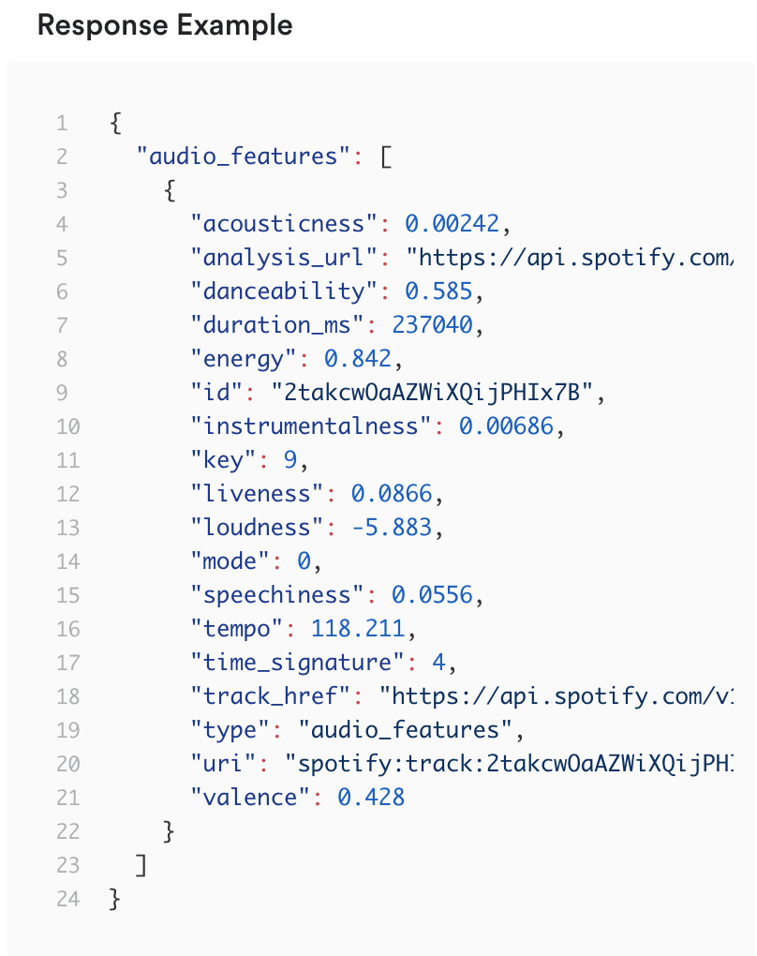
Data Collection
Spotify API
Endpoints Used
/search
  Searches for a song based on a query
  eg: search?q=song_name: name year: year)
/audio_features
  Extracts audio features from songs based on a track id (or up to 100)
  Features include acousticness, danceability, energy, instrumentalness, liveness, loudness, speechness, tempo, and valence
/tracks/{id}
  Gets data about specific tracks
Notes:
Data fetching - Aditya
Show example code and test run demo

Slide 5
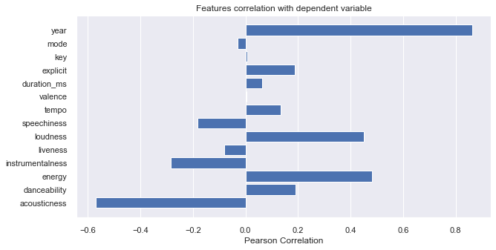
Data Preprocessing
Scaled loudness and tempo on a scale from 0-1 to make all values compare at the same scale
Feature selection done through correlation plot
Notes:
Feature vectorization + selection - Aditya
Some features are more useful than others, and to avoid problems that come with high dimensionality (to be described in detail later), features that would prove to be useful were carefully scrutinized.
For example, features like - and - were redundant and therefore not included. <- could be backed up by a model with and without that feature and showing that the results don't change.

Slide 6
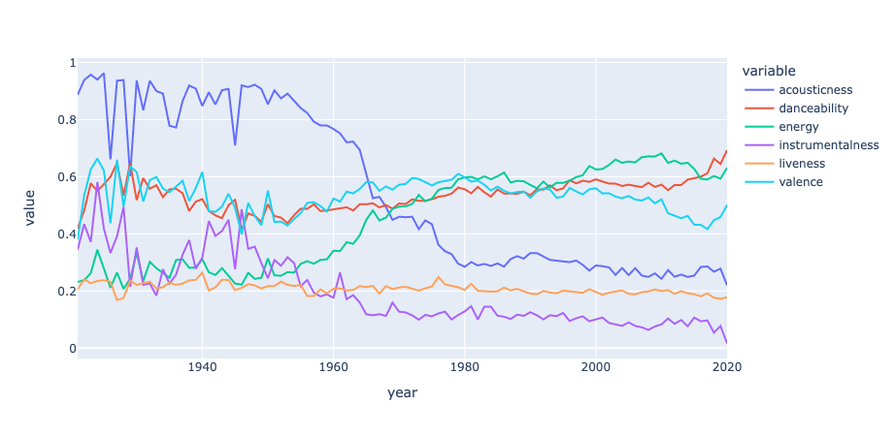
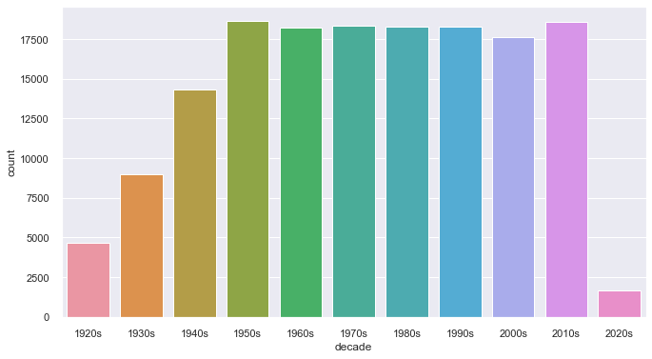
Data Visualization
Notes:
Feature vectorization + selection - Aditya
Some features are more useful than others, and to avoid problems that come with high dimensionality (to be described in detail later), features that would prove to be useful were carefully scrutinized.
For example, features like - and - were redundant and therefore not included. <- could be backed up by a model with and without that feature and showing that the results don't change.

Slide 7
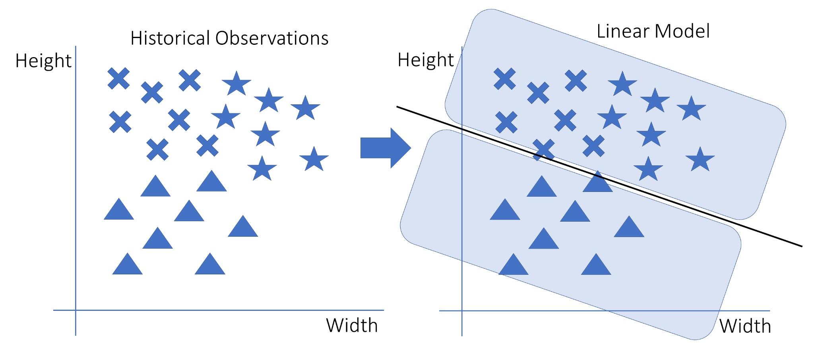
Premise - Spacial search
We have a set of points with quantitative features
Number of features = number of axes/dimensions
Close points are defined into clusters
Supervised
Unsupervised
Notes:
Now we have a set of songs that are quantified across 9 continuous features. Identifying points that are similar or dissimilar to each other is a nearest neighbors problem. We arrange points along a set of axes and plot them. Points with similar values across most dimensions will present on the graph.
We can classify ”similar” points into categories. For example, a classification could cover the set of points with an acousticness below .1, and energy above .9, and so on, considering all the features collectively. So it’s important to select features that are relevant to what defines a meaningful category.
The supervised implementation uses a training data set in which each point already belongs to a cluster. In this picture example, points are in three classes, X’s, stars, and triangles. We also notice that the classes follow a pattern where X’s have low width and high height, stars have high width and height, and so on. The algorithm then seeks to identify borders of these classes, creating categories based on distances.
We doing an unsupervised implementation because we are not using classifications like genres.

Slide 8
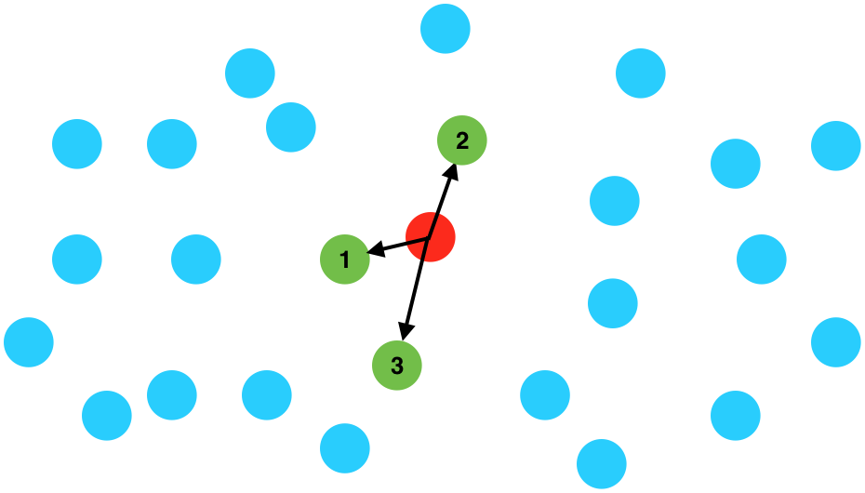
Premise, cont.
Given a query point q, find what category it’s in
Which points is it closest to? Nearest neighbors
Notes:
Representing points spatially is very helpful in discerning like categories, because we can calculate the geometric distance between points as a measure of similarity. This forms the basis of the Nearest Neighbors algorithm, which seeks to determine if some undefined point, q (for query point), belongs in a certain category based on if points around it are in it or not.

Slide 9
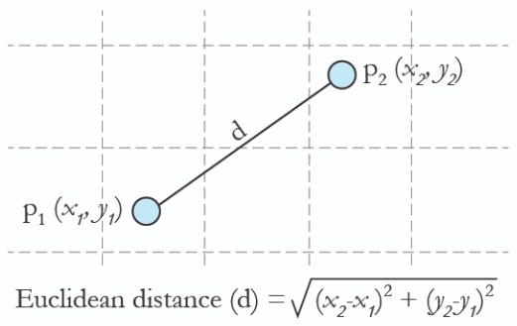
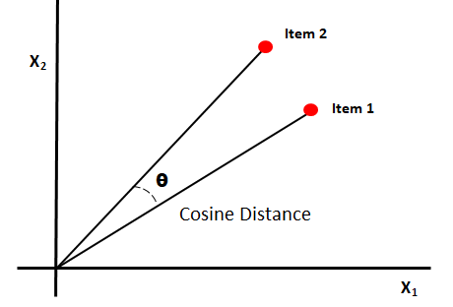
Recommendation Algos.
Nearest Neighbors
The more similar the nodes, the closer neighbors they are
“Closeness” metrics
Euclidean distance
Cosine similarity
Notes:
This is pretty easy to compute. Commonly it’s the simple euclidean distance, but cosine distances may be more helpful in higher dimensions

Slide 10
Space Partitioning
Classic Jazz
I’ll Be Seeing You - Billie Holiday
A: 0.98 E: 0.03 T: 90
Cheek to Cheek - Ella Fitzgerald
A: 0.76 E: 0.2 T: 134
In A Sentimental Mood - John Coltrane
A: 0.93 E: 0.3 T: 108
2000’s R&B
Rock the Boat - Aaliyah
A: 0.07 E: 0.7 T: 92.9
Sugar Mama - Beyoncé
A: 0.2 E: 0.9 T: 93.8
No Scrubs - TLC
A: 0.02 E: 0.6 T: 92.9
q₁ Didn’t Cha Know - Erykah Badu A: 0.48 E: 0.47 T: 135
q₂ Numb - Linkin Park A: 0.004 E: 0.86 T: 110
Notes:
Here’s an example set of 8 songs, most of which I already know the genre/category they belong to. (Which makes this like a supervised example). For simplicity’s sake, I’ve only included 3 features: A for acousticness, E for energy, and T for tempo.

Slide 11
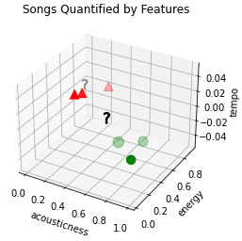
NN visualization
q₁: Didn’t Cha Know - Erykah Badu
q₂: Numb - Linkin Park
Notes:
Although I’ve labeled the jazz songs as green circles and the rnb songs as red triangles, we can see that they form natural clusters where they fall in the 3d space. The two query points are question marks, and we can see that Don’t Cha Know by Erykah Badu is very close neighbors with the rnb songs. Numb, on the other hand, isn’t close neighbors with any points, and is kind of ambiguously like the average of all the songs in the set.

Slide 12
Brute force k-NN w/ Data Structure
Nearest Neighbor Search
Set S of points in space M and a query point q ∈ M, find the n closest points in S to q
Naive: Linear search
Compare distances between q and all points in S
No search data structures
Time complexity: O(DN²)^{[1]}
Find the top k nearest neighbors
Uses tree-based data structures like Ball Trees (for very large datasets) or k-D Trees
Space complexity varies
Time complexity: O[DN log(N)]^{[1]}
Curse of Dimensionality: If D gets bigger, algorithms become slower
Notes:
Aditya
N is the number of nodes in the set and d is the number of dimensions in the space
In our example, M is the playlist containing N songs. The query point is a new song that the user is known to like. The query gets added to space M and the algorithm searches for k number of songs closest to q. In principle, a user would enjoy the near neighbors of a song they are known to like.
Complexities:
For the brute-force neighbor search of the kNN algorithm, we have a time complexity of O(n×m), where n is the number of training examples and m is the number of dimensions in the training set

Slide 13
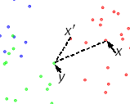
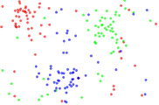
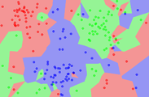
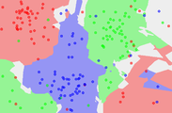
Algorithm Tuning: K-NN example
Border Ratio: a(x) = ||x'-y||/||x-y||
Altering k
higher k = farther lookout
The dataset 1NN - Closer look 5NN - Farther look
Notes:
Aditya
Because the category of each point is given, this is represents the more typical supervised implementation
Lower k considers more immediate surroundings
Higher k creates stricter classifications - of your k nearest neighbors, the classification that
In 5NN we see that some regions are unclassified, and that’s because there can be a tie. For example, if the 5 nearest neighbors consist of 2 green, 2 blue, and 1 red.

Slide 14
k-D Trees
A type of BST where each node has k dimensions.
Level:
  Each level corresponds to a dimension and rotates back as the tree has more children.
Child direction:
  Left subtree if: Based on level alignment, the smaller coordinate corresponding to the level gets the left subtree.
  Right subtree if: Based on level alignment, the bigger coordinate corresponding to the level gets the right subtree.
Notes:
A K-Dimensional Tree is a Binary Search Tree where each node has K-Dimensions.
Determine Level:
Each level corresponds to a dimension and rotates back as the tree has more children.
Determine Subtree direction:
Left subtree if: Based on level alignment, the smaller coordinate corresponding to the level gets the left subtree.
Right subtree if: Based on level alignment, the bigger coordinate corresponding to the level gets the right subtree.

Slide 15
k-D Trees (how we used it)
As explained in the previous slide, each node in a KD-Tree has ‘K’ dimensions in each node.
Our KD-Tree has 9 dimensions in each node as we are using 9 attributes per song.
All songs are represented as a tree and when a song is inputted,
  We traverse down the tree to find the nearest point (most similar song)
  We go up past the nearby nodes above (opposite subtree) that we missed to ensure that all nearby nodes are explored
Our KD-Tree is represented as huge matrix (size = [~150,000 songs x 9 features]) which is represented as a sparse matrix for ease of computation.
  Consider each row in the matrix as a node (a single song)
  Each row, column, and value is broken down into a sparse matrix
  The input song and its attributes are passed into the model and compared with the sparse matrix, this results in a specified set of similar songs.
Notes:
As explained in the previous slide, each node in a KD-Tree has ‘K’ dimensions in each node.
Our KD-Tree has 9 dimensions in each node as we are using 9 attributes per song.
All songs are represented as a tree and when a song is inputted,
We traverse down the tree to find the nearest point (most similar song)
We go up past the nearby nodes above (opposite subtree) that we missed to ensure that all nearby nodes are explored
Our KD-Tree is represented as huge matrix (size = [~150,000 songs x 9 features]) which is represented as a sparse matrix for ease of computation.
Consider each row in the matrix as a node (a single song)
Each row, column, and value is broken down into a sparse matrix
The input song and its attributes are passed into the model and compared with the sparse matrix, this results in a specified set of similar songs.

Slide 16
Example of a KD-Tree with Spotify Data
Songs:
[(0.98, 0.03, 90), ->1 (0.76, 0.2, 134), ->2 (0.93, 0.3, 108), ->3 (0.07, 0.7, 92.9), ->4 (0.2, 0.9,93.8), ->5 (0.02,0.6,92.9),->6 (0.48,0.47,135), ->7 (0.004,0.86,110) ->8]
1
A
2
E
3
T
4
7
A
6
5
8
E

Slide 17
Results
k-D Tree Model
Brute-Force Model
487 µs ± 44 µs per loop
mean ± std. dev. of 7 runs, 10 loops each
6.76 ms ± 772 µs per loop
mean ± std. dev. of 7 runs, 1000 loops each
Took 10 loops to run
Took 1000 loops to run
Time complexity is better which is O(DNlog(N))^{[1]} , where D=9
Time complexity is not as good which is O(D(N²)), where D=9
When D>20, algorithm becomes infeasible
When Number of samples grow (N), the model becomes infeasible
Notes:
Talk about complexity of both models

Slide 18
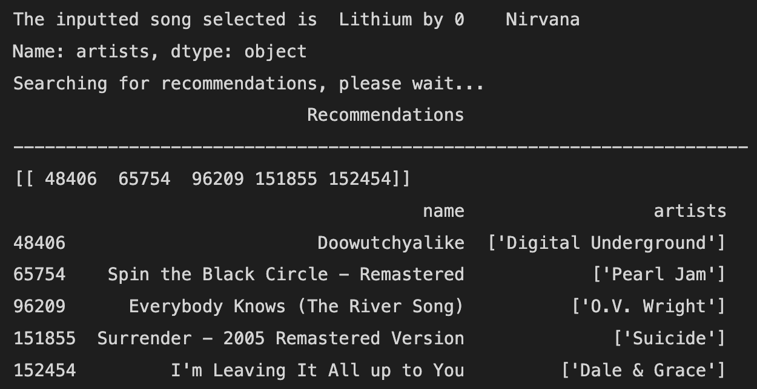
Recommendation Example

Slide 19
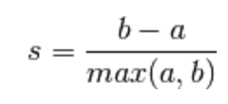
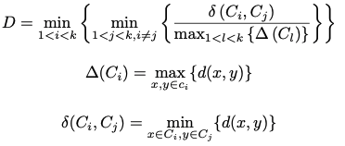
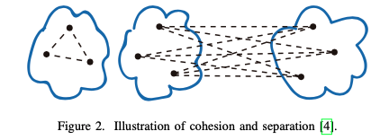
Challenges
Unsupervised Learning algorithms are difficult to evaluate due to the absence of a ground truth
Common Methods to Evaluate Unsupervised Models
Silhouette Coefficient ^{[2]}
  The mean distance between a sample and all other points in the same cluster.
  The mean distance between a sample and all other points in the next nearest cluster.
  [-1, 1] → score is higher when clusters are dense and well separated
Dunn’s Index ^{[2]}
  Ratio of smallest distance between data of different clusters and largest distance between clusters
  Should be maximized for best performance result
Cohesion
Proximity
Palacio-Niño, J. and Berzal, F., 2022. Evaluation Metrics for Unsupervised Learning Algorithms. Available at: <https://arxiv.org/abs/1905.05667>.

Slide 20
References
[1] Parikshit Ram and Kaushik Sinha. 2019. Revisiting kd-tree for Nearest Neighbor Search. In <i>Proceedings of the 25th ACM SIGKDD International Conference on Knowledge Discovery &amp; Data Mining</i> (<i>KDD '19</i>). Association for Computing Machinery, New York, NY, USA, 1378–1388. DOI:https://doi.org/10.1145/3292500.3330875
[2] Palacio-Niño, J. and Berzal, F., 2022. Evaluation Metrics for Unsupervised Learning Algorithms. Available at: <https://arxiv.org/abs/1905.05667>

